Slide 1

AI-powered research tasks in biotech
IntelliBio
Your Bridge between Gen AI productivity and
Life Science Innovation.

Slide 2

Our mission: 30% R&D productivity gains using generative AI
Image is customizable

Slide 3
Problem
Generative AI will transform R&D workflows, problem solving by researchers, and discovery & design.
But:
1
Biotech SMEs are constrained on resources to develop & integrate.
3
The security of Cloud-based AI is a red flag for 80% of biotechs².
2
Data quality is a concern for 80% of biotech teams¹.
4
Generic AI applications do not translate well to biotech use cases.
Nature Biotechnology. (2023). Data Quality Challenges in Biotech AI Adoption.
European Medicines Agency. (2022). Survey on AI Adoption in European Biotech SMEs.

Slide 4




Solution
Empowering biotech teams with a tailored Gen AI suite to break through constraints, streamline workflows, and unlock unprecedented productivity with intelligent automation and AI-driven insights.
Time-Saving Workflow AI
Specialized for research tasks
Embedding & SLMs for
rapid, precise contextual understanding
Secure On-Premise AI
Protects IP and secures privacy
Collaborative dashboard
Enhances team efficiency

Slide 5



Market Validation
Value per customer validated at >€30,000 per year
Validated price first offering at €1,000 (single use case)
Current validation in the market:
Current offering: IntelliBio has developed 3x AI agents (MVP)
Sales; Grant Genie at €1,500 (3 sales with 50% discount)
Paying customers:

Slide 6



Market Size
Gen AI-driven productivity to add €21B value to biotech by 2025
The value of Generative AI within biotech will shortly exceed the (€38B) SaaS for biotech market.
Initial target market is 2,300 biotech SMEs in Europe.
Value per customer validated at >€30,000 per year.

Slide 7
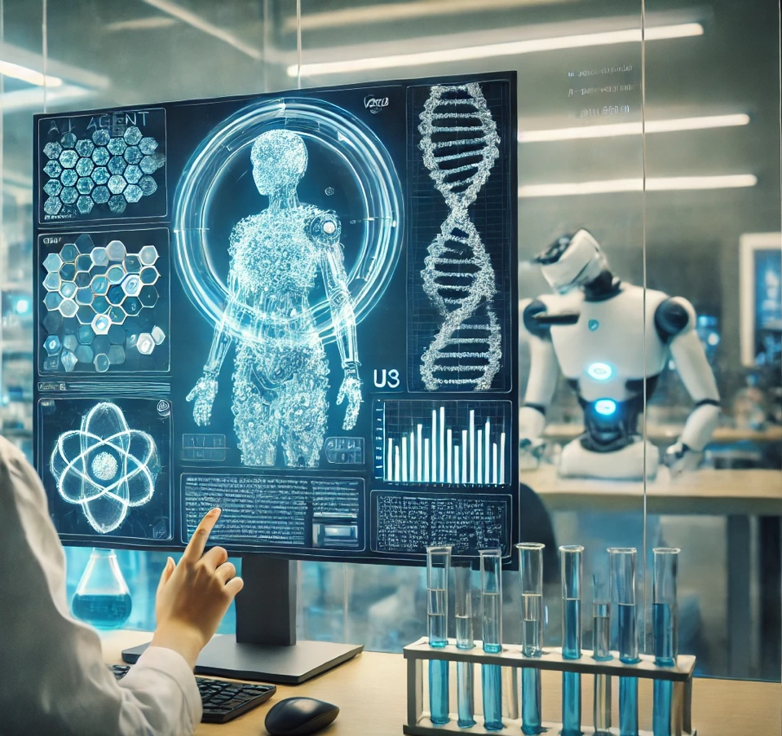
Product
"Our AI-powered platform leverages embeddings and Small Language Models (SLMs) to deliver secure, on-premise solutions that empower biotech teams to accelerate research, automate workflows, and unlock faster innovation with unparalleled productivity."
Image is customizable

Slide 8
Business Model
IntelliBio intents to operate as a AI-a-a-S business.
Launch Grant Genie: Establish market presence & initial revenue.
Develop On-Prem PoC: Validate with biotech SMEs.
Expand offering of AI agents: Develop modular AI capabilities.
Scale Operations: Use follow-up funding to expand products.
Build AI Suite: Offer €30k–€100k/year modular solutions.

Slide 9
Competition
By addressing gaps in data privacy, integration complexity, and cost-effectiveness, our AI-powered platform provides secure solutions with customizable tools designed for their unique research needs.
Advantages
Disadvantages
Comprehensive all-in-one platforms (e.g. Benchling).
Foundational model R&D (e.g., DeepMind).
Cloud Accessibility & Seamless remote collaboration.
Data Privacy Concerns: Limited security for sensitive data.
High Costs: Expensive for smaller biotech firms.
Rigid AI Tools: Limited customization for workflows.

Slide 10



Our Team
Dr. Boaz van Driel CEO & co-founder
Leonard Gonsalves CTO & co-founder
Enrico Maset
Advisor & Partner
Our Founding Team:
Bridging Life Science Innovation with Technological Excellence
Our Partner:
Leveraging funding for rapid growth.

Slide 11
Testimonials
Our customers recognize our long-term potential and short-term value.
“… Profs here [] all are very excited to try [Grant Genie] …!”
“You need a respectable biotech to work with as launching customer, I think my new venture Gyes BV can be that.”
- Neuroscience prof. at ETH (Swiss)
“That is really good quality, only needed a few edits.”
– Ton Logtenberg, ex-CEO Merus
– Fred Vaz, Director metabolomics lab

Slide 12


Financial Model
We generate revenue through a subscription-based model with modular upselling for additional AI capabilities, complemented by on-premise AI deployments supplied via trusted third-party vendors.

Slide 13
Thank You
IntelliBio
Further contact: Boaz van Driel, PhD | CEO IntelliBio BV
boazceo@intellibio.tech
+31 6 53715300

